Slide 2
Unit Objectives
Understand CSS layouts
Create a page using CSS layouts
Add content to CSS layout blocks
Edit content in CSS layout blocks
Edit CSS layout properties
Understand table modes
Insert a table and set table properties
Merge and split table cells
Insert and align images in table cells
Add text
Format and modify cell content
Format cells

Slide 3
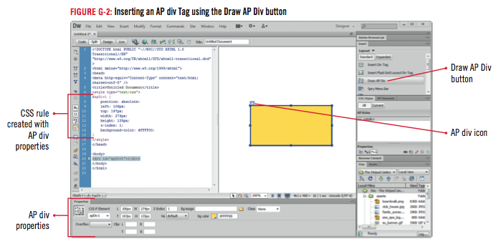
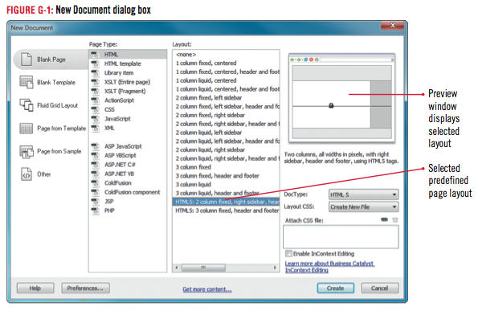
Understanding CSS Layouts
Using Cascading Style Sheets vs. tables for page layout
Using Dreamweaver CSS page layouts
Using AP divs
Using HTML and CSS

Slide 4
Clues to Use
Using Dreamweaver sample pages
Use Welcome Screen or New Document dialog box to create several different types of pages
Use CSS Style Sheet and Mobile Starters options as starting points to develop pages for mobile devices and style sheets
Fluid Grid Layout is used for designing adaptive websites based on a single fluid grid

Slide 5
Creating a Page Using CSS Layouts
Open The Striped Umbrella website, then switch to Design view
Click File on the Menu bar, click New
Verify that Blank Page is highlighted in the left section, click HTML in the Page Type category if necessary, then click HtML5: 2 column fixed, right sidebar, header and footer in the Layout column
If “Create New File” does not appear in the Layout CSS text box, click the Layout CSS list arrow, click Create New File
If the su_styles.css file is shown in the Attach CSS file text box in the New Document dialog box, skip to step 6.

Slide 6
Creating a Page Using CSS Layouts
- If not, click the Attach style sheet button in the lower-right corner of the dialog box, then click Browse in the Attach External Style Sheet dialog box
Click the su_styles.css file in the Select Style Sheet File dialog box
Click OK (Win) or click Choose (Mac)
Then click OK
Verify that the Add as: Link option button is selected in the Attach External Style Sheet dialog box
Then click OK

Slide 7
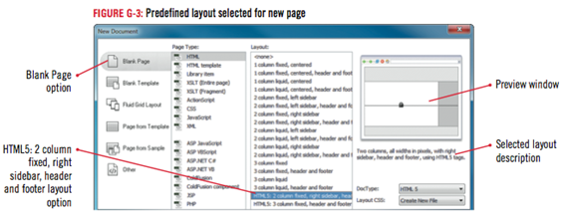
Creating a Page Using CSS Layouts
Click Create in the New Document dialog box, verify that the HtML5_twocolFixRtHdr.css file will be saved in the striped_umbrella local site folder in the save style sheet File As dialog box, then click Save to close the save style sheet File As dialog box. Open the CSS styles panel if necessary, then expand the HtML5_twocolFixRtHdr.css and su_styles.css style sheets
Save the file as cafe.html, overwriting the existing file

Slide 8
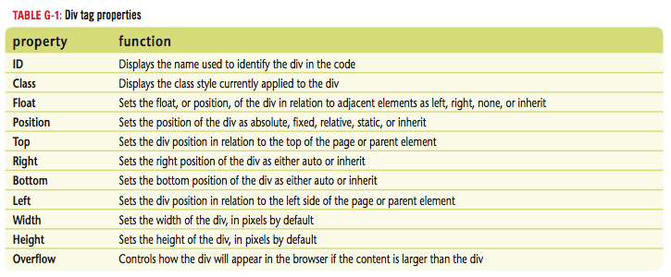
Creating a Page Using CSS Layouts

Slide 9
Adding Content to CSS Layout Blocks
Select all content between the Header and Footer in the main section, as shown in Figure G-6, then press [Delete]
Change to the HTML Property inspector, click the Format list arrow, then click Paragraph
Import the Word document cafe.doc from the drive and folder where you store your Unit G Data Files (Win) or copy and paste it (Mac) at the insertion point
Switch to code view, select the code between the beginning and end of the <div class=”sidebar1”> tag, then press [Delete]
Return to Design view, then type Reservations are recommended for beach 25 (our main dining room) during the peak summer season. at the insertion point

Slide 10
Adding Content to Divs
Delete all of the text in the footer block, type copyright 2002 - 2015 the striped Umbrella, as shown in Figure G-8, then save your work
Open the index page and copy both the banner and the menu bar, then close the index page
Click the placeholder logo image on the cafe page, then paste the banner and menu bar in its place
Place the insertion point at the end of the paragraph ending with “poolside.”, enter a paragraph break, insert cafe_photo.jpg from the assets folder in the drive and folder where you save your Unit G Data Files, then type Sand Crab Cafe photo for the alternate text

Slide 11
Design Matters
Understanding selector types
Order of precedence
Pseudo class styles
Group selectors
Descendant selector

Slide 12
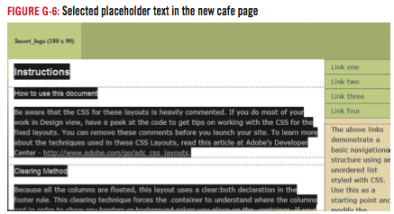
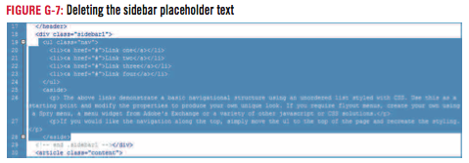
Adding Content to CSS Layout Blocks

Slide 13
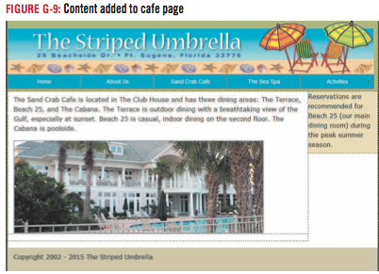
Adding Content to CSS Layout Blocks

Slide 14
Editing Content in CSS Layout Blocks
Click the .sidebar1 rule in the HtML5_twocolFixRtHdr.css file in the css styles panel, click the Edit Rule button, click the Block category, click the Text-align list arrow, then click center
Click the Box category, change the Float from right to left, click the Background category, change the background color to #FFF, then click OK
Click the header rule in the HtML5_twocolFixRtHdr.css file in the CSS styles panel to select it,
Click the Edit Rule button, click the Background category, change the background color to #FFF
Click the Box category, type 5 in the Top Margin text box, verify that the Same for all check box is checked, as shown in Figure G-11, then click OK

Slide 15
Editing Content in CSS Layout Blocks
Click the footer rule in the HtML5_twocolFixRtHdr.css file in the CSS styles panel to select it, click the Edit Rule button, click the Background category, change the background color to #FFF, click the Block category, change the text-align to center, then click OK
Save your work

Slide 16
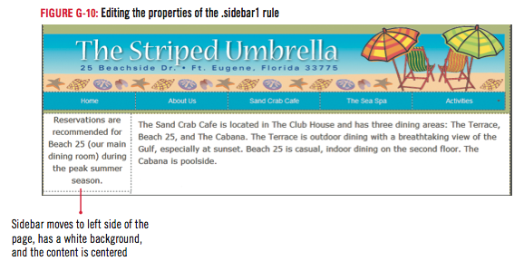
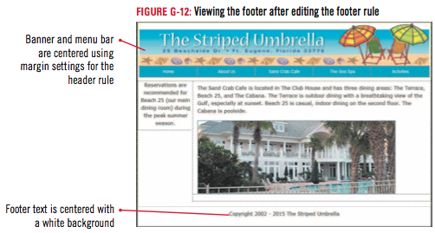
Editing Content in CSS Layout Blocks

Slide 17
Clues to Use
Using Visual Aids to work with dives
Several options for viewing your divs in Design view:
Show or hide outlines
Temporarily assign different background colors to individual divs
View CSS Layout Box Model
To change options, use the View, Visual Aids menu, and then select or deselect the appropriate menu choice

Slide 18
Editing CSS Layout Properties
Select the body rule in the HtML5_twocolFixRtHdr.css file in the CSS styles panel, click to select the existing background color in the Properties pane, type #FFF as shown in Figure G-13, then press [Enter] (Win) or [return] (Mac)
Click .container in the HtML5_twocolFixRtHdr.css file in the CSS styles panel, click the Edit rule button, then click the Border category
Click the Top list arrow in the style column, click solid, click the Top list arrow in the first text box in the Width column, click thin,
Click in the First color text box in the color column, type #033, verify that the Same for all check box is selected in each of the three columns
Compare your screen to Figure G-14, then click OK

Slide 19
Editing CSS Layout Properties
Type The Striped Umbrella Beach Resort and Spa, Ft. Eugene, Florida in the title text box on the Document toolbar
Click to place the insertion point in front of the word “Reservations” in the sidebar, then enter a line break
Save your work, preview the page in the browser, compare your screen to Figure G-15, then close the browser

Slide 20
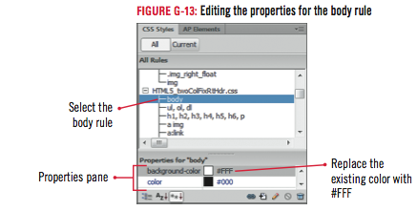
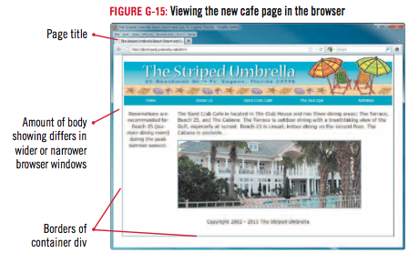
Editing CSS Layout Properties

Slide 21
Design Matters
Using the Adobe CSS Advisor
Browser Compatibility Check (BCC) feature
Used to check for CSS features that may render differently in multiple browsers
Flags and rates code on three levels
CSS Advisor on Adobe Web site offers solutions
Adobe BrowserLab another useful tool

Slide 22
Understanding Table Modes
Inserting a table in Standard mode
Width
Border
Cell padding
Cell walls
Cell spacing
Viewing a table in Expanded Tables mode
Lets you view a table with expanded table borders and temporary cell padding and cell spacing

Slide 23
Clues to Use
Using HTML table tags
Table tags
<table> </table>
Table row tags
<tr> </tr>
Table data cell tags
<td> </td>
Nonbreaking space code &nbsp is placed in each table cell at the time it’s created

Slide 24
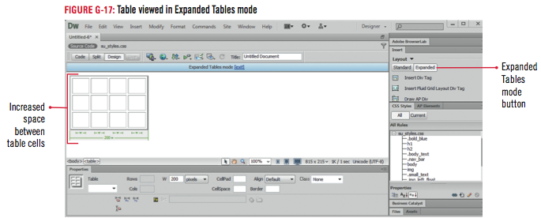
Understanding Table Modes

Slide 25
Design Matters
Placing the most important information first
Put it at the top of the page
Use guides to make sure important content is “above the fold”

Slide 26
Inserting a Table and Setting Table Properties
With the insertion point to the right of the cafe photo, enter a paragraph break, then click Table in the common category of the Insert panel
Type 5 in the Rows text box, 3 in the Columns text box, click Top in the Header section if necessary, type The Sand Crab Cafe Hours in the Caption text box, compare your screen to Figure G-18, then click OK
Click the New CSS Rule button in the CSS Styles panel, choose Tag (redefines an HTML element) in the Selector Type text box, type table in the Selector Name text box, choose su_styles.css in the Rule Definition list box, then click OK
Click the Box category, type 600 in the Width text box, verify that px is the unit of measure, change the Float to left, then click OK

Slide 27
Clues to Use
Selecting a table
Click insertion point in the table
Click Modify on teh Menu bar, point to Table, then click Select Table
By moving the pointer slowly to the top or bottom edge of the table, then clicking the table border when the pointer changes
If the insertion point is in the table, click <table> on the tag selector

Slide 28
Inserting a Table and Setting Table Properties

Slide 29
Design Matters
Formatting Tables with HTML5 and CSS3
Many of the HTML codes used to format tables in HTML4 are now considered to be deprecated
Use CSS to format tables by creating a rules to modify table properties and table content

Slide 30
Merging and Splitting Table Cells
Click to place the insertion point in the first cell in the top row, then drag the pointer to the right to select all three cells in the top row
Click the Merges selected cells using spans button in the Property inspector
Place the insertion point in the first cell in the fifth row, then click the Splits cell into rows or columns button in the Property inspector

Slide 31
Merging and Splitting Table Cells
Click the Split cell into: Rows option button to select it if necessary, type 2 in the Number of rows text box if necessary, as shown in Figure G-21, then click OK
Click the Show Code view button on the Document toolbar
Click the Show Design view button on the Document toolbar, select and merge the first cells in rows 2, 3, 4, and 5 in the left column, deselect the cell, compare your screen to Figure G-23, then save your work

Slide 32
Clues to Use
Using nested tables
Use when you want parts of your table data to contain both visible and invisible borders
A nested table is separate from the original table so it can be formatted separately
More nested tables means more complicated coding

Slide 33
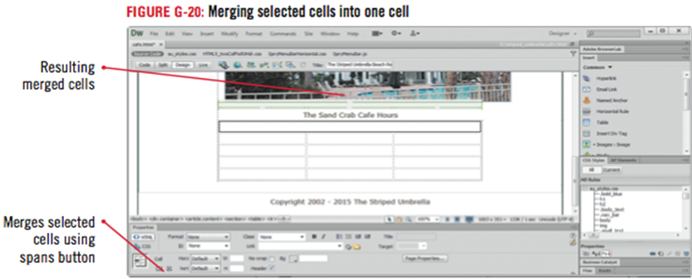
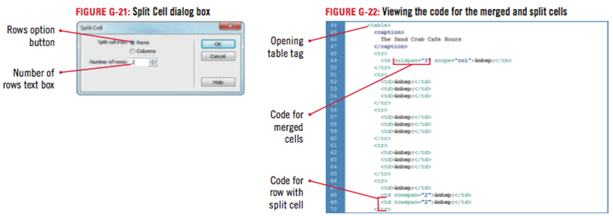
Merging and Splitting Table Cells

Slide 34
Merging and Splitting Table Cells

Slide 35
Inserting and Aligning Images in Table Cells
Click to place the insertion point in the first cell in the second row of the table
Change to the common category on the insert panel
Click the images button list arrow, click image, navigate to the drive and folder where you store your Unit G Data Files
Then double-click chocolate_cake.jpg from the assets folder
Type Chocolate Grand Marnier Cake in the alternate text box, click OK, then refresh the Files panel
Click to the right of the chocolate_cake image in the same cell to place the insertion point
Switch to code view, then place the insertion point right after the code “<td rowspan=”4”

Slide 36
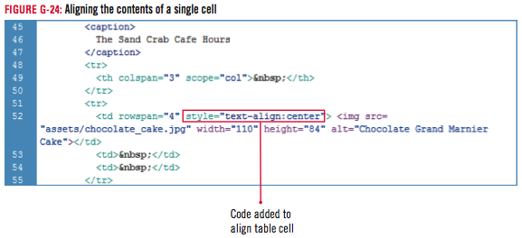
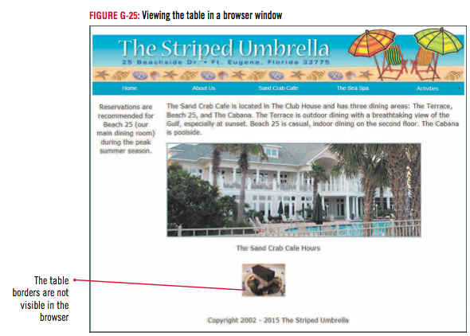
Inserting and Aligning Images in Table Cells
Press the Spacebar to enter a space, then type style=”text-align:center” as shown in Figure G-24
Return to Design view, then save your work
Preview the page in your browser, view the table with the aligned image then close the browser

Slide 37
Design Matters
Recognizing and addressing printing issues
Page background colors do not print
Page might be too wide to print in portrait orientation
Table borders, horizontal rules, and CSS divs may not print exactly how they look in a browser

Slide 38
Adding Text
Click in the first cell in the last row, type Chocolate, press [Shift] [Enter] (Win) or [shift] [return] (Mac) to add a line break, type Grand Marnier, add another line break, then type Cake
Click in the top row of the table, then type Our individual dining areas are listed below:
Enter the names for each dining area and its hours in rows 1 through 3, as shown in Figure G-26
Merge the second and third cells in the last row, then type the room service information from Figure G-26 with a line break after 12:00 a.m.

Slide 39
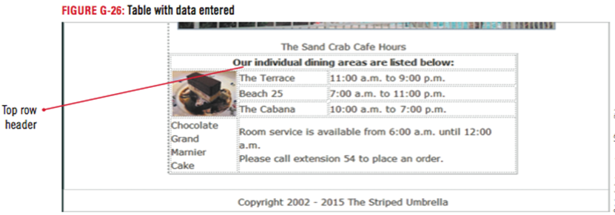
Adding Text
Click the <table>tag on the tag selector
Click the table rule in the CSS Styles panel, click the Edit rule button, click the Box category, change the box width to 635 px, click OK, then compare your screen to Figure G-27
Save your work

Slide 40
Formatting and Modifying Cell Content
Expand the CSS Styles panel group if necessary
Click the table rule in the CSS Styles panel,
Click the Edit Rule button, click the Type category, click the Font-family list arrow, click Arial, Helvetica, sans-serif, click the Font-size list arrow, click medium, then click OK
Click the New CSS Rule button, then create a new class selector type rule called featured_item in the su_styles.css style sheet file
In the type category, set the Font-size to 14, the Font-weight to bold, the Font-style to italic, the color to #003, as shown in Figure G-29, then click OK

Slide 41
Formatting and Modifying Cell Content
Select the Chocolate Grand Marnier Cake text under the chocolate cake image, click the CSS button in the Property inspector, then apply the featured_item rule to the text
Click after the word Cake in the bottom-left cell, then press [Tab]
Merge the cells in the new row, click in the merged cells, click Insert on the Menu bar, point to HTML, then click Horizontal Rule
Save your work, preview the cafe page in your browser, compare your screen to Figure G-30, then close your browser

Slide 42
Formatting and Modifying Cell Content

Slide 43
Formatting Cells
Click to place the insertion point in the cell with the chocolate cake caption
Click the .featured_item rule in the css styles panel, then click the Edit Rule button
Click the Block Category, click the Text-align list arrow, click center, then click OK
Place the insertion point in the cell with the room service information, then switch to Code view
Place the insertion point at the end of the opening td tag, type style=”text-align: center”, as shown in Figure G-32
Save all files, switch to Design View, click the Switch Design View to Live View button , then compare your screen to Figure G-33
Return to Design view, close all open pages, then exit Dreamweaver

Slide 44
Unit Summary
Understand CSS layouts
Create a page using CSS layouts
Add content to CSS layout blocks
Edit content in CSS layout blocks
Edit CSS layout properties
Understand table modes
Insert a table and set table properties
Merge and split table cells
Insert and align images in table cells
Add text
Format and modify cell content
Format cells

